Slide 1
Optimal Service Deployment for Network Function Virtualization
Jack Polk
Dr. Deng Pan
August 11th, 2017
Notes:
*** Good morning/afternoon everyone; my name is Jack Polk and I will be presenting my research on optimal service deployment for network function virtualization, which I have had the honor to work on with my mentor, Dr. Deng Pan in the school of computing and information sciences.

Slide 2
Introduction
Notes:
*** Before we begin, let us first go into exactly what virtualization technology is, how it operates, and what we can use it for in computer networking

Slide 3
Virtualization Technology
Translating physical hardware components into software components
Advantages: reduced cost, scalability, easy management
Notes:
*** A virtual machine is a software computer that, like a real computer, has the ability to run its own operating system and applications.
*** This enables reduced cost, higher scalability, and easier management for administrators

Slide 4
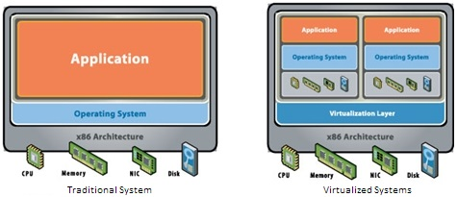
Notes:
*** In traditional systems, a computers resources support an operating system
*** In a virtual machine, there is a virtualization layer which allows systems resources to be allocated to separate operating systems.
*** CUE NEXT SET OF PICTURES ***
*** Here we can see some examples of VM Hypervisors, which facilitate virtual machines

Slide 5
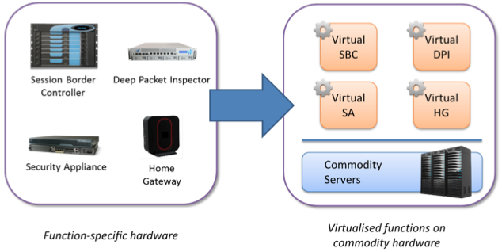
Network Function Virtualization (NFV)
Traditional network functions can now be accomplished with virtualization technology
Notes:
*** Similar to how virtual machines replace physical systems with virtualized systems, network function virtualization (NFV) replaces traditional networking hardware with virtual machines that substitute their functions.
*** One example would be replacing a traditional $50K firewall with a virtual machine, reducing the cost by a substantial amount.

Slide 6
Challenge
How can we minimize network latency and congestion caused by traditional network devices?
What role can VMs play in solving this issue?
Notes:
*** Our challenge is how we can utilize NFV in a manner that allows for the most efficient placement of VMs in a traffic flow, to ensure that latency is kept low and that traffic is evenly distributed throughout the network.
*** To approach this problem, we use two rules.

Slide 7
Basic Idea
Replace traditional networking hardware with VMs
01
Implement the MinMax routing algorithm
02
Implement the Least First Greatest Last (LFGL) rule
03
Notes:
*** 1.) First, we will replace traditional networking hardware with virtual machines
*** 2.) Then, we will implement the MinMax Routing Algorithm to reduce network congestion and
*** 3.) Lastly, we will implement the LFGL Rule alongside the MinMax routing algorithm to optimize VM placement in specific traffic flows

Slide 8
Methods
Notes:
*** Moving into our methods, we will now discuss the previously mentioned rules

Slide 9
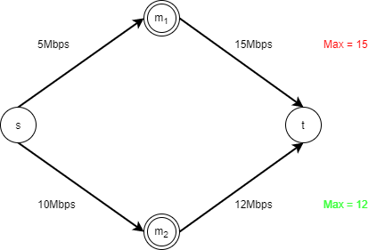
MinMax Routing Algorithm
The MinMax routing algorithm will determine which path has the lowest maximum link load, allowing for increased bandwidth and lower latency
Important for decreasing network congestion
Example: 12Mbps is the lowest maximum
Max = 12
Notes:
*** Network congestion can be seen in real world situations, like when several people use the same Wi-Fi network to stream movies and the users may notice an increase in buffering. The network being used becomes congested and this is what leads to buffering
*** To prevent network congestion, the MinMax routing algorithm keeps the maximum link load to the lowest possible level, increasing bandwidth and decreasing congestion.
*** As observed in the example, there are two flows, each of which have a maximum link load. Because the lower flow has the smallest maximum link load, this will be the chosen path.

Slide 10
Least First Greatest Last (LFGL) Rule
The Least First Greatest Last rule (LFGL) places low traffic changing VMs at the beginning of the flow and high traffic changing VMs at the end of the flow
Using LFGL, latency can be decreased substantially
Notes:
*** The LFGL rule will place VMs with the lowest traffic-changing effect at the beginning of the flow and VMs with the highest traffic-changing effect at the end of the flow
*** In the example above, the colored dots represent VMs and the color indicates whether its traffic changing effect is negative or positive. If a VM has a traffic changing effect that is negative, the traffic size is reduced and with VMs that have a traffic changing effect that is positive, the traffic size is increased.

Slide 11
Benchmark Solutions
First-Fit (Example)
Last-Fit (Example)
Random-Fit (Example)
Notes:
*** For a baseline, three benchmark solutions are used that the LFGL rule will be compared against
*** CUE FIRST-FIT ***
*** The first-fit rule starts at the beginning of the flow and places VMs from the least traffic changing effect to the greatest traffic changing effect
*** CUE LAST-FIT ***
*** The last-fit rule starts at the end of the flow and places VMs from the greatest traffic changing effect to the least traffic changing effect, going in the direction of the beginning of the flow
*** CUE RANDOM-FIT ***
*** The random-fit rule places VMs in random places along the flow, no matter the traffic changing effect

Slide 12
Data analysis
Notes:
*** Moving on to data analysis, the following data was obtained after implementing a LFGL based MinMax routing algorithm in a small-scale tree topology.

Slide 13
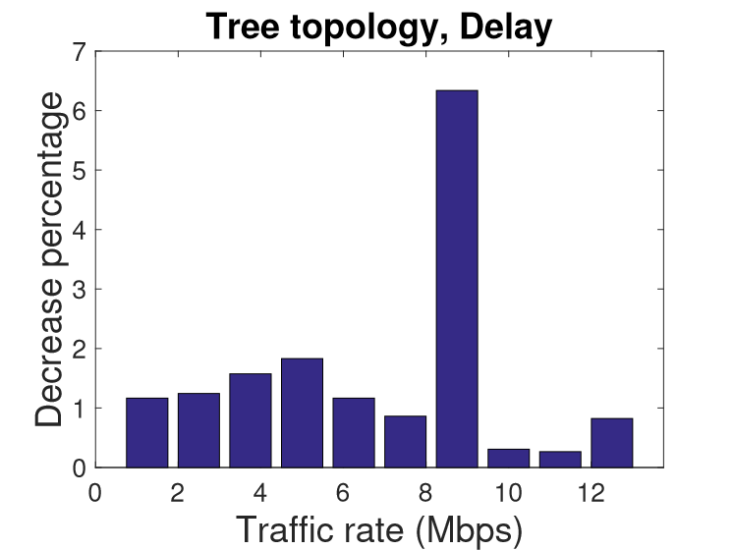
Tree Topology Delay (ms)
Notes:
*** When compared to the benchmark solutions, there is a consistent decrease in latency when LFGL is implemented.

Slide 14
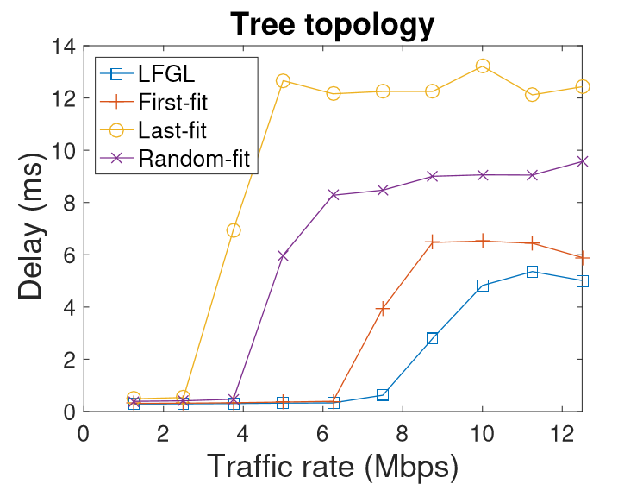
Tree Topology Delay (ms)
Notes:
*** When looking at a side-by-side comparison of the tests, last-fit performed the poorest, with random-fit and first fit following suite. Only LFGL can score the lowest delay times.

Slide 15
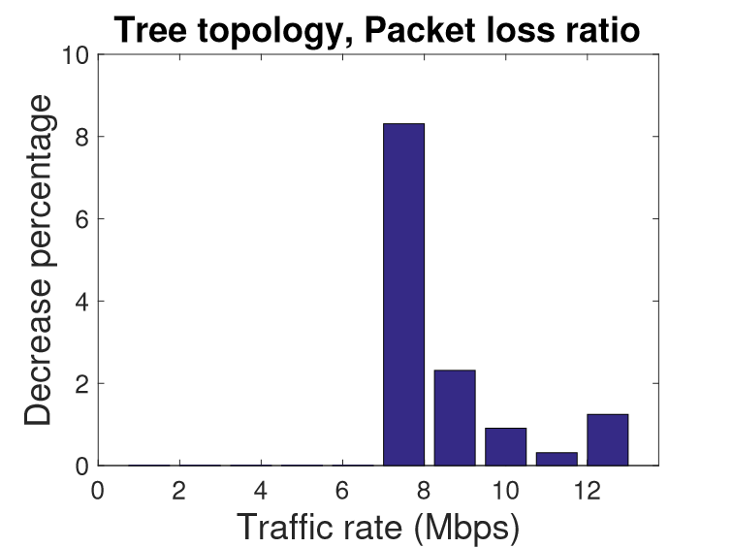
Tree Topology Packet Loss (%)
Notes:
*** For packet loss, all solutions perform relatively well at first, until the traffic rate increases to around 7Mbps, where information is then lost
*** LFGL has a drastically lower rate of packet loss, with all other solutions losing a sizeable amount more.

Slide 16
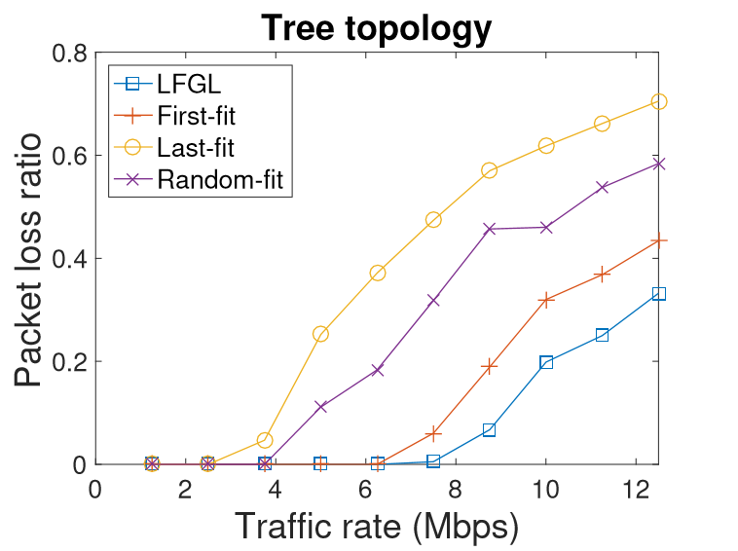
Tree Topology Packet Loss
Notes:
*** Performing a side-by-side comparison of packet loss, as seen again at around 7Mbps, LFGL outperforms the other solutions.
*** Also, important to note is that LFGL is the only solution able to stay stable longer, as the others begin to lose packets before LFGL does.

Slide 17
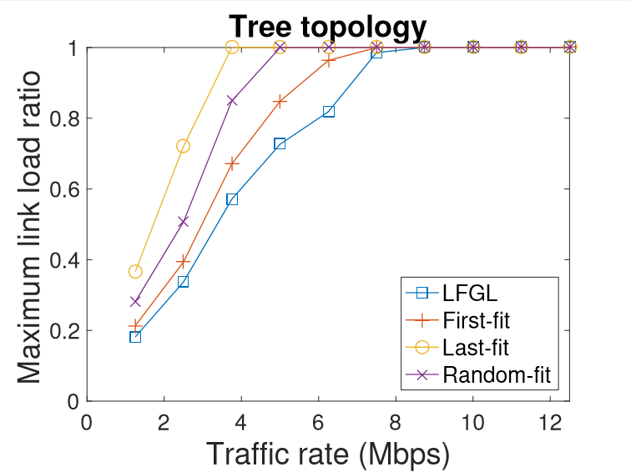
Tree Topology Link Load
Notes:
*** If we look at how the traffic changing effect of VMs is managed differently, each solution manages VM placement in such a way that impacts the bandwidth of the flow in relation to the maximum link capacity.
*** In the case of LFGL, as traffic rate increases, it sustains the lowest traffic rate in relation to the maximum link load.

Slide 18
Conclusions
Notes:
*** Concluding this presentation, it can be said that…

Slide 19
Conclusions
An overall decrease in latency, maximum link load, and packet loss was achieved
Replacing traditional networking hardware with VMs increases modularity and cost-effectiveness
Notes:
*** With the use of the LFGL based MinMax routing algorithm, we successfully optimized VM placement based on their traffic changing effects
*** This information can be applied to real world situations for drastic performance improvements in large scale networks

Slide 20
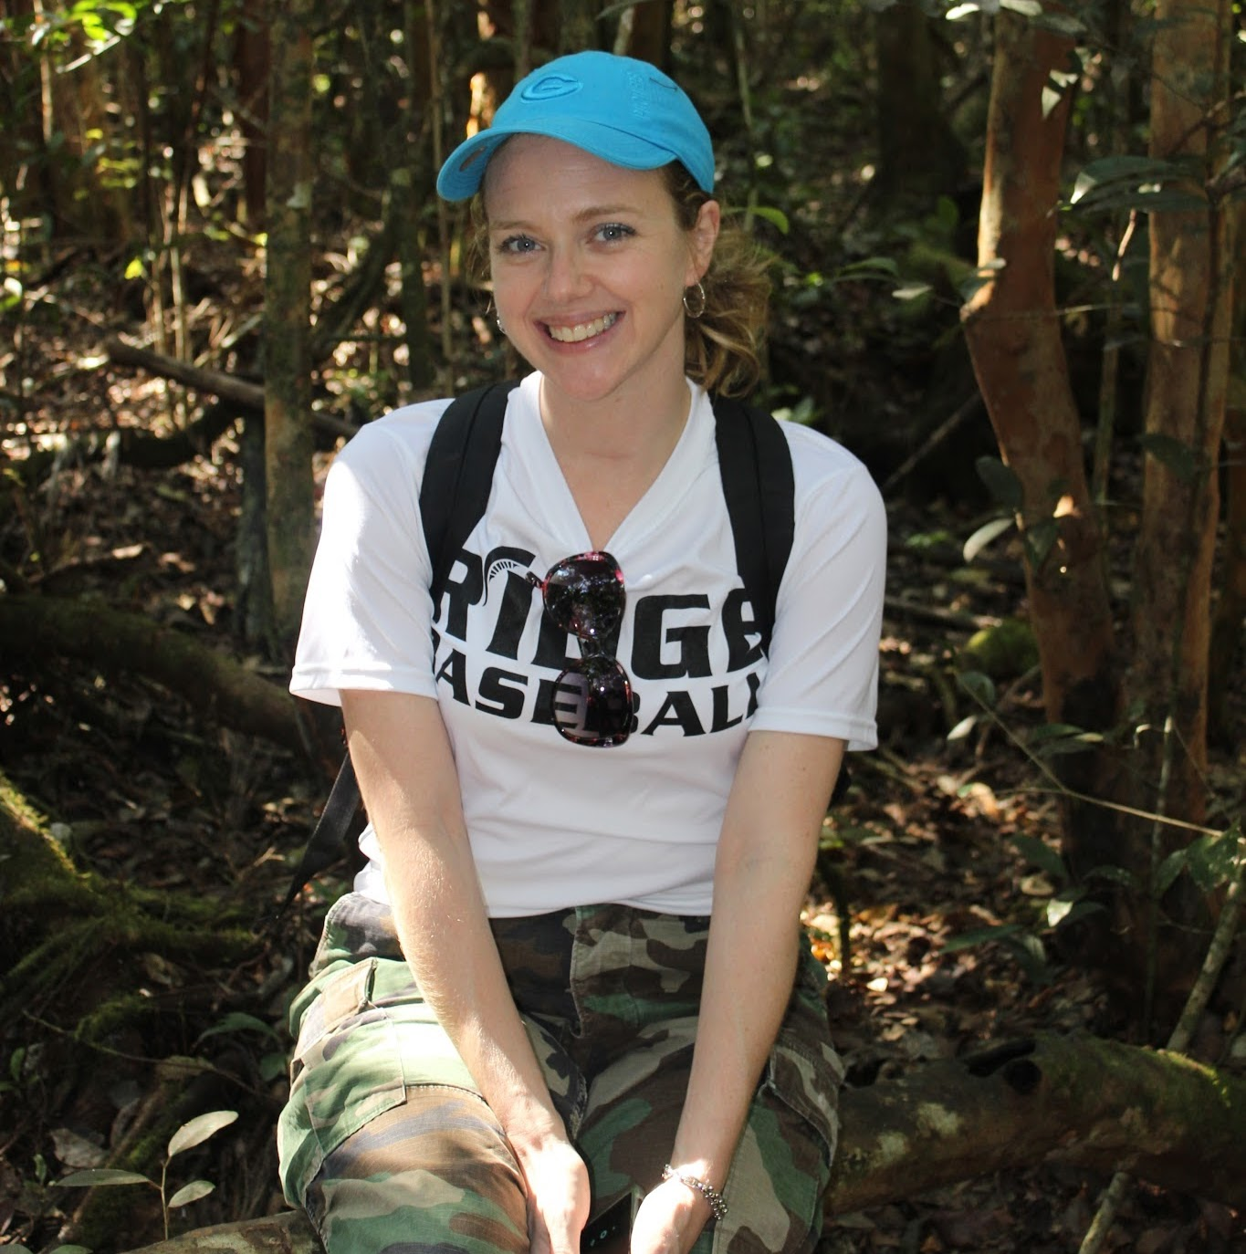
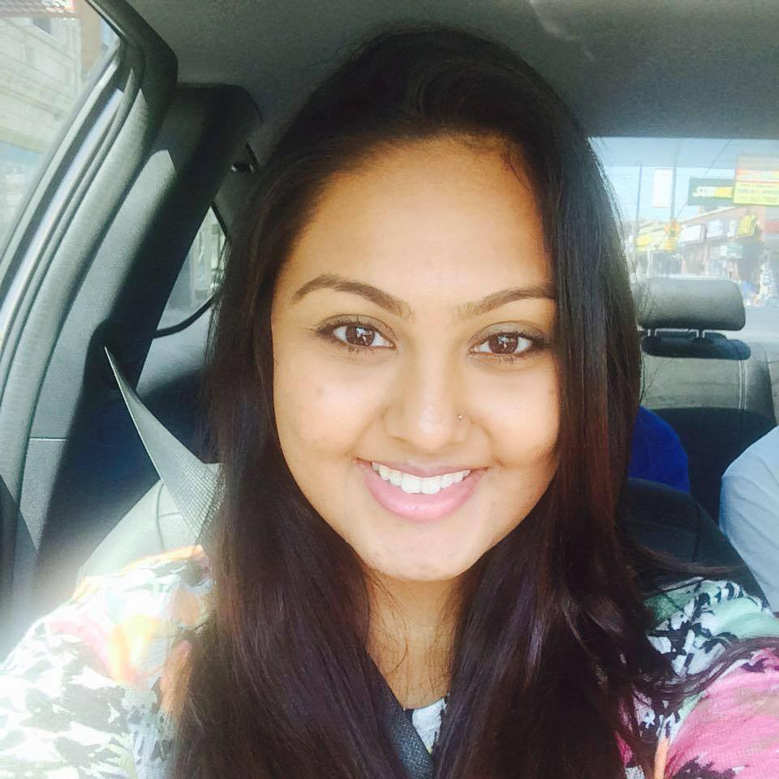
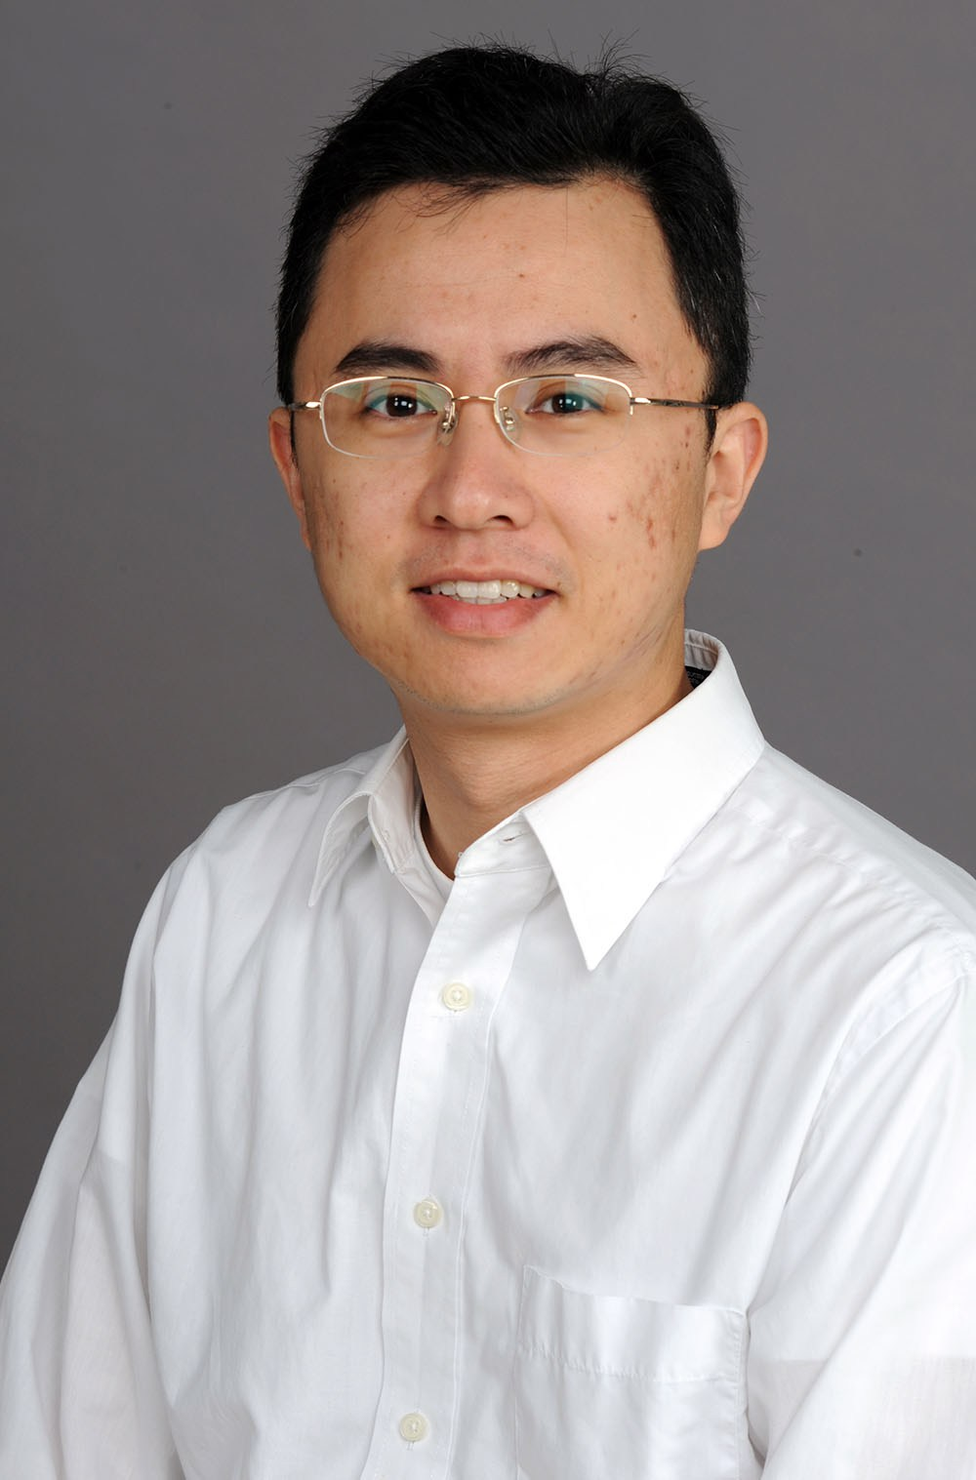
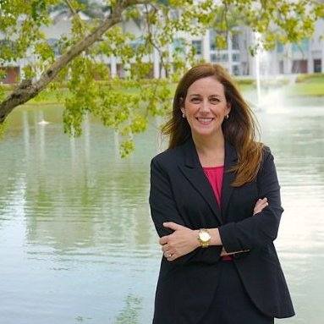
Acknowledgements
Dr. Deng Pan
FIU School of Computing and Information Sciences
Amy Reid, Asfa Siddiqui, and the SRI Program
Medical Academy of Science and Technology
Jennifer Barreto
Notes:
*** I would like to take some time out of this presentation to thank all of those who have made me being here possible; My mentor Dr. Deng Pan, the school of computing and information sciences, Ms. Amy Reid and Ms. Asfa Siddiqui, who have coordinated this wonderful program, my school, the medical academy of science and technology, and the two teachers who this wouldn’t be possible without, Mr. Brian Ruhmann and Ms. Jennifer Barreto.

Slide 21
Discussion
Questions and feedback are welcome!
Notes:
*** We will now have time for questions and feedback

